Slide 1
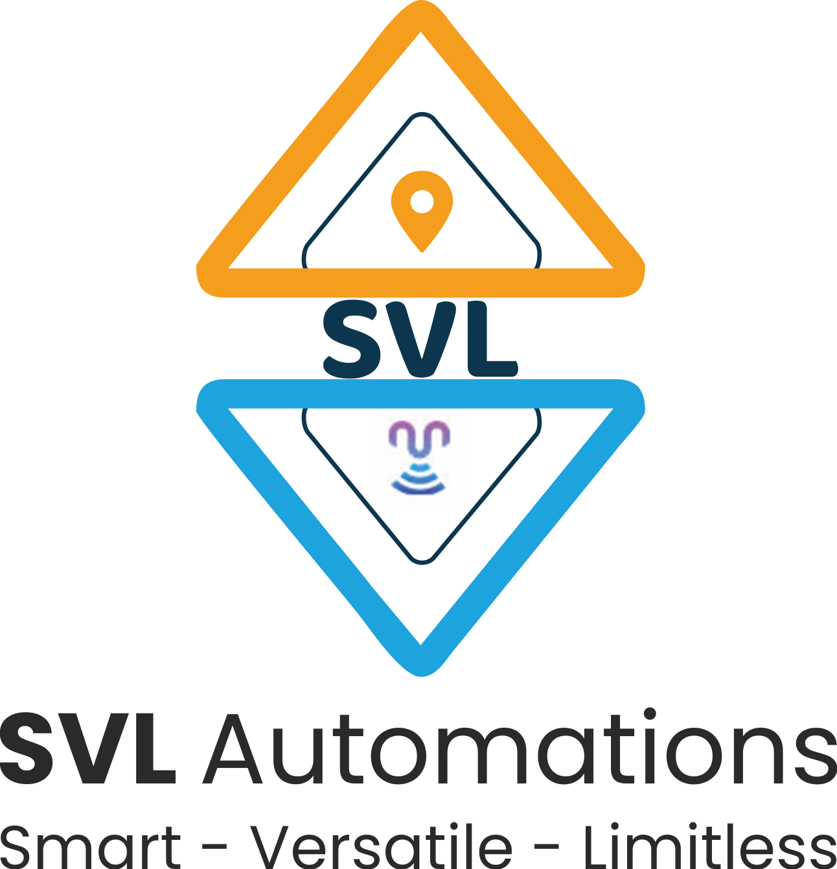
Introduction to Python Programming
Functions
Ms. Shital H. Dinde

Slide 2
Function
A function is a block of code that performs a specific task whenever it is called.
In bigger programs, where we have large amounts of code, it is advisable to create or use existing functions that make the program flow organized and neat.
There are two types of functions:
built-in functions: These functions are defined and pre-coded in python.
Ex. min(), max(), len(), sum(), type(), range(), dict(), list(), tuple(), set(), print(), etc.
user-defined functions: We can create functions to perform specific tasks as per our needs. Such functions are called user-defined functions.

Slide 3
User defined function
Syntax
def function_name(parameters):
Code and Statements
Create a function using the def keyword, followed by a function name, followed by a paranthesis (()) and a colon(:).
Any parameters and arguments should be placed within the parentheses.
Rules to naming function are similar to that of naming variables.
Any statements and other code within the function should be indented.

Slide 4
def name(fname, lname):
print("Hello,", fname, lname)
name("Sam", "Wilson")
We call a function by giving the function name, followed by parameters (if any) in the parenthesis.

Slide 5
Function Arguments
There are four types of arguments that we can provide in a function:
Default Arguments
Keyword Arguments
Required Arguments
Variable-length Arguments

Slide 6
Default arguments:
We can provide a default value while creating a function.
This way the function assumes a default value even if a value is not provided in the function call for that argument.
def name(fname, mname = "Jhon", lname = "Whatson"):
print("Hello,", fname, mname, lname)
name("Amy")

Slide 7
Keyword arguments
We can provide arguments with key = value, this way the interpreter recognizes the arguments by the parameter name.
Hence, the order in which the arguments are passed does not matter.
def name(fname, mname, lname):
print("Hello,", fname, mname, lname)
name(mname = "Peter", lname = "Wesker", fname = "Jade")

Slide 8
Required arguments
In case we don’t pass the arguments with a key = value syntax, then it is necessary to pass the arguments in the correct positional order and the number of arguments passed should match with actual function definition.
def name(fname, mname, lname):
print("Hello,", fname, mname, lname)
name("Peter", "Quill")
name("Peter", "Ego", "Quill")

Slide 9
Variable-length arguments
Sometimes we may need to pass more arguments than those defined in the actual function. This can be done using variable-length arguments.
There are two ways to achieve this:
Arbitrary Arguments
Keyword Arbitrary Arguments

Slide 10
Arbitrary Arguments
While creating a function, pass a * before the parameter name while defining the function.
The function accesses the arguments by processing them in the form of tuple
def name(*name):
print("Hello,", name[0], name[1], name[2])
name("James", "Buchanan", "Barnes")

Slide 11
Keyword Arbitrary Arguments
While creating a function, pass a * before the parameter name while defining the function.
The function accesses the arguments by processing them in the form of dictionary.
def name(**name):
print("Hello,", name["fname"], name["mname"], name["lname"])
name(mname = "Buchanan", lname = "Barnes", fname = "James")

Slide 12
return Statement
The return statement is used to return the value of the expression back to the main function
def name(fname, mname, lname):
return "Hello, " + fname + " " + mname + " " + lname
print(name("James", "Buchanan", "Barnes"))

Slide 13
Python Recursion
any function can call another function
A function can even call itself.
When a function call itself, it is making a recursive call.
Recursive Call
A function call in which the function being called is the same as the one making the call.
Recursion is a powerful technique that can be used in the place of iteration(looping).
Recursion
Recursion is a programming technique in which procedures and functions call themselves.

Slide 14
Approach
Solve small problem directly
Simplify large problem into 1 or more smaller subproblem(s) & solve recursively
Calculate solution from solution(s) for subproblem
Definition
A definition in which something is defined in terms of smaller versions of itself.
To do recursion we should know the followings
Base Case:
The case for which the solution can be stated non-recursively
The case for which the answer is explicitly known.
General Case:
The case for which the solution is expressed in smaller version of itself. Also known as recursive case.

Slide 15
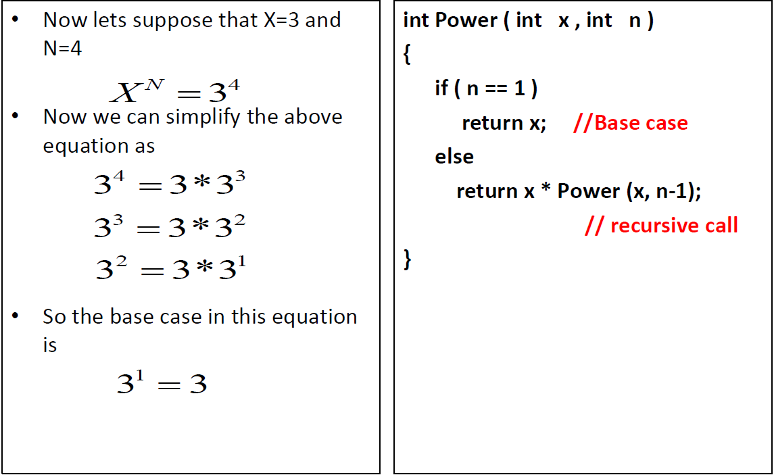
Example

Slide 16
Factorial definition
n! = n ×n-1 ×n-2 ×n-3 ×… ×3 ×2 ×1
0! = 1
To calculate factorial of n
Base case
If n = 0, return 1
Recursive step
Calculate the factorial of n-1
Return n ×(the factorial of n-1)

Slide 17
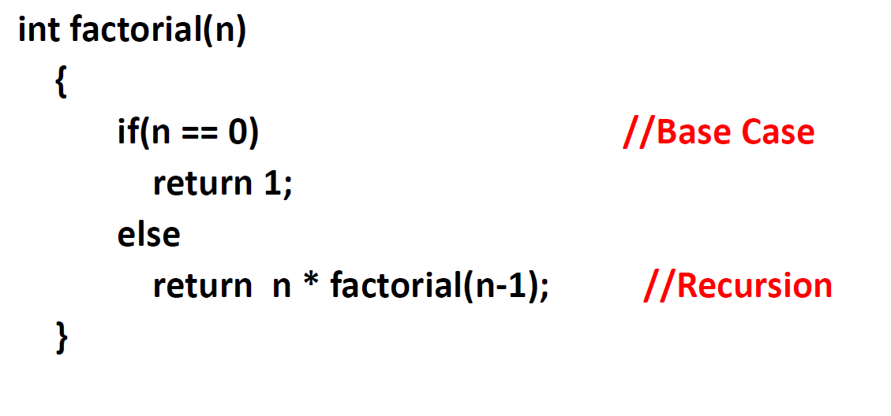

Slide 18
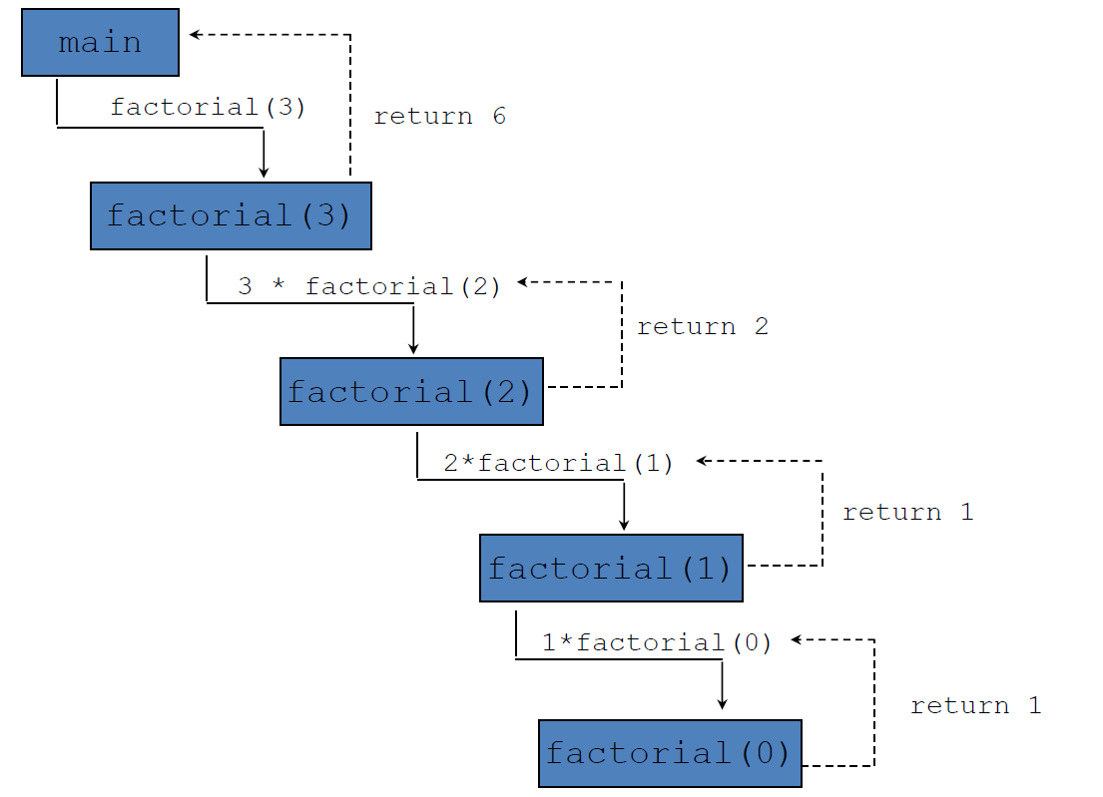

Slide 19
Rules For Recursive Function
In recursion, it is essential for a function to call itself, otherwise recursion will not take place.
Only user define function can be involved in recursion.
To stop the recursive function it is necessary to base the recursion on test condition and proper terminating statement such as exit()or returnmust be written using if() statement.
When a recursive function is executed, the recursive calls are not implemented instantly. All the recursive calls are pushed onto the stack until the terminating condition is not detected, the recursive calls stored in the stack are popped and executed.
During recursion, at each recursive call new memory is allocated to all the local variables of the recursive functions with the same name.

Slide 20
Write a Python function that takes a positive integer and returns the sum of the cube of all the positive integers smaller than the specified number. if n=5 then answer should be ans=1³+2³+3³+4³ = 100
Write a function intreverse(n) that takes as input a positive integer n and returns the integer obtained by reversing the digits in n.
Write a Python function that accepts a string and calculate the number of uppercase letters and lower case letters.

Slide 21

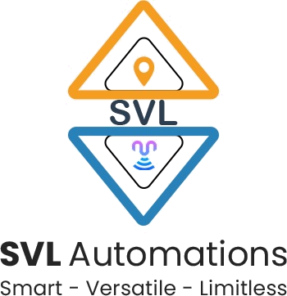
Questions?

Slide 22

8888 763 563
88 5335 4141
https://svlautomations.in
https://svltrainings.in

